Slide 1



Social Determinants of Health

Slide 2


What Are Social Determinants of Health?
Why Are Social Determinants Important?
Key Determinants of Health
The Canadian Context.
Who are the policy makers
Introduction

Slide 3




Objectives
01
02
03
04
How do socio economic characteristics and health related characteristics differ across Canadian provinces and and what implications do these differences have for targeted policy-making?
How does the expenditure on education correlate with other features among the provinces?
What provinces should be taken into consideration to create a more equitable, healthy, and prosperous society?
What are the possible actions that can be taken by the policy makers to improve the conditions?

Slide 4

Data analysis and sources
Statistics Canada
Statscan
Canadian Public Health association
The Canadian facts
Canadian best Practices portal
Other literary resources.

Slide 5

S
W
STRENGTHS
WEAKNESSES
High GDP
Economic prosperity
Educational access
Geographical disparity
Income inequality
Drug abuse
O
T
OPPORTUNITIES
THREATS
Targeted policy interventions
Health education
Collaborative initiatives
Economic instability
Aging population
Social inequalities

Slide 6


ANALYSIS

Slide 7
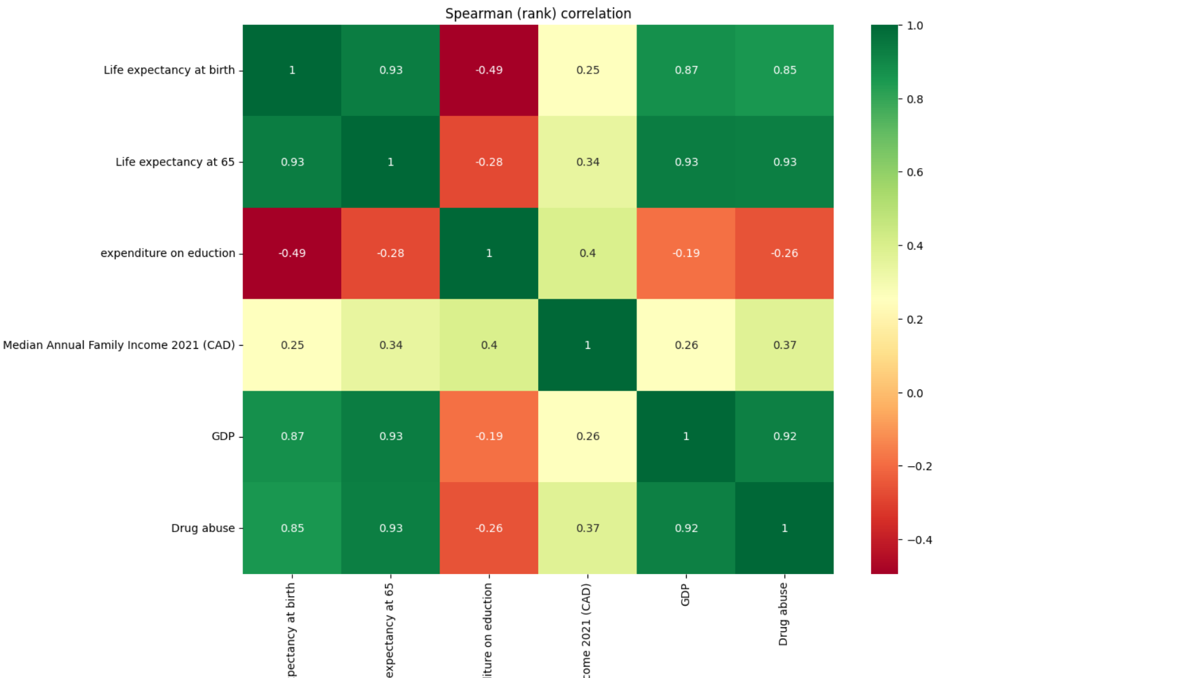
CORRELATION
Health Outcomes
Life expectancy at birth and at 65 are strongly correlated.
Economic prosperity (GDP) significantly contributes to better health outcomes.
Education
Expenditure on education shows weaker or negative correlations with life expectancy and GDP.
Factors beyond financial investment influence educational and health outcomes.
Income and Drug Abuse
Median family income and GDP strongly correlate with higher drug abuse.
Wealthier regions may experience more social stress, contributing to drug abuse.
Economic Factors
GDP strongly affects life expectancy and drug abuse.
Weak link with education spending shows need for targeted investments.

Slide 8
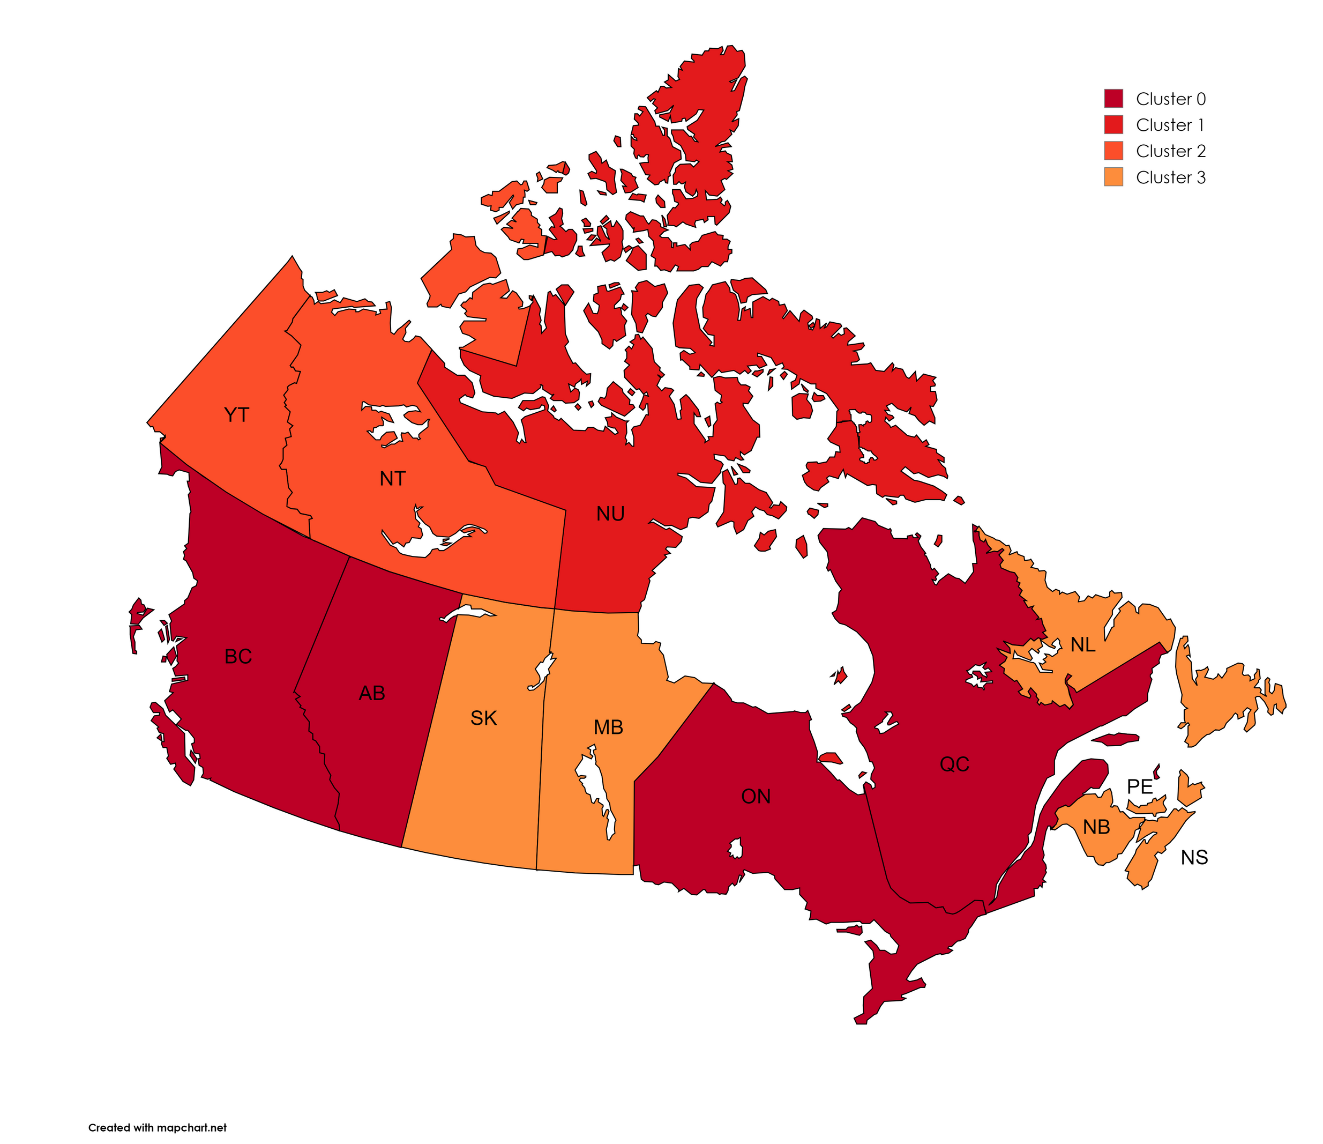
This analysis combines K-Means Clustering and Principal Component Analysis (PCA) to understand the socio-economic and health-related characteristics of Canadian provinces. The PCA reduces dimensionality and helps visualize provincial differences, while K-Means Clustering groups provinces with similar profiles.

Slide 9
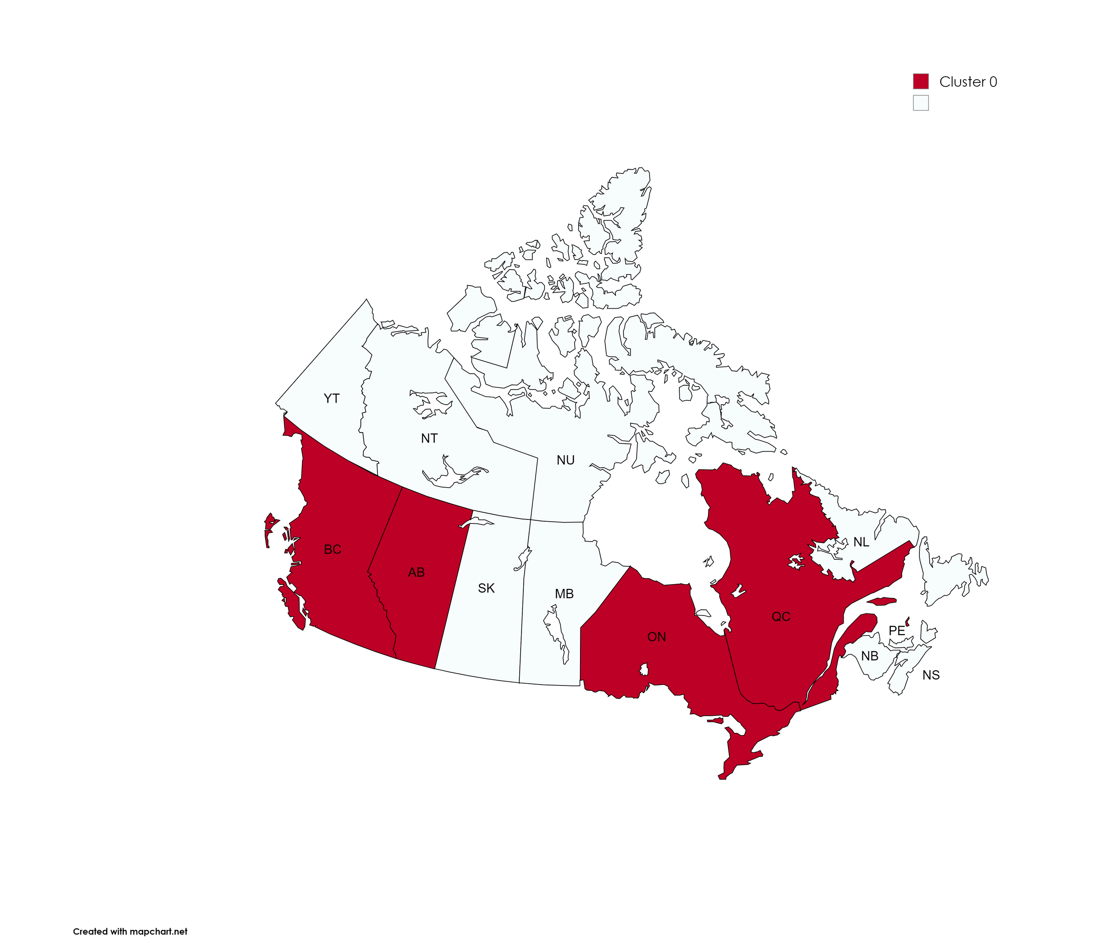
Cluster 0:
Provinces: Quebec, Ontario, Alberta, British Columbia
Characteristics:
High GDP and median family income.
Higher life expectancy and education expenditure.
Well-developed healthcare and economic infrastructure.

Slide 10
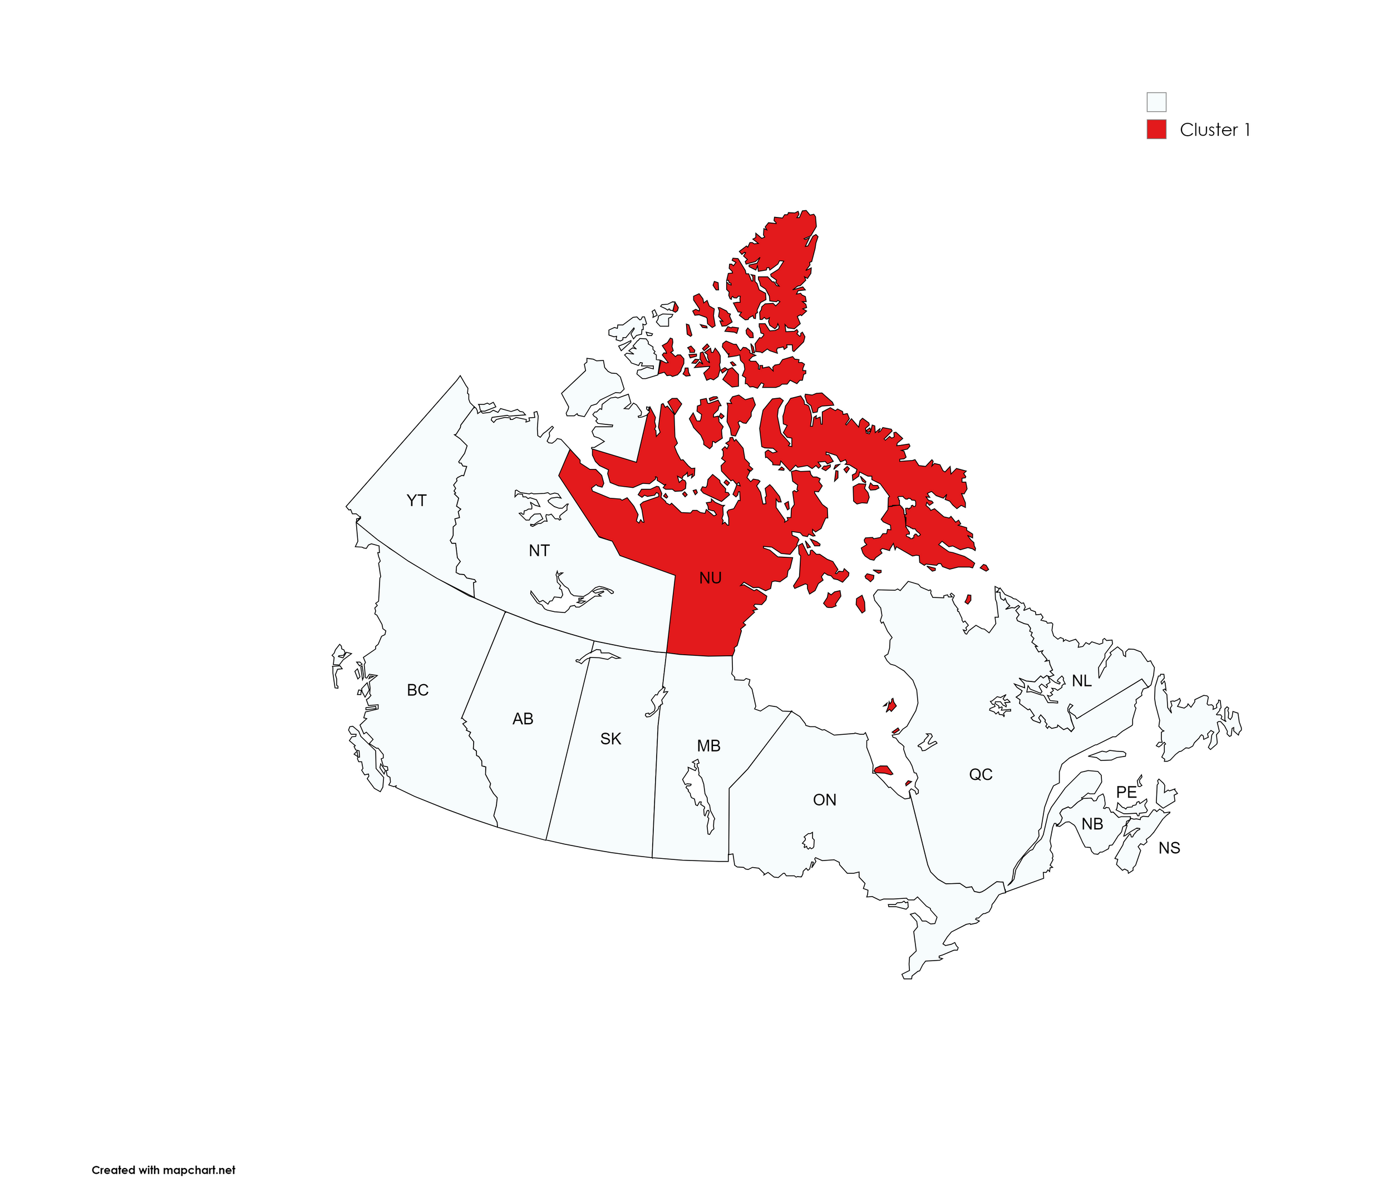
Cluster 1:
Province: Nunavut
Characteristics:
Lowest life expectancy and highest drug abuse rates.
Distinct socio-economic challenges due to geographical isolation.
Lower education expenditure and GDP.

Slide 11
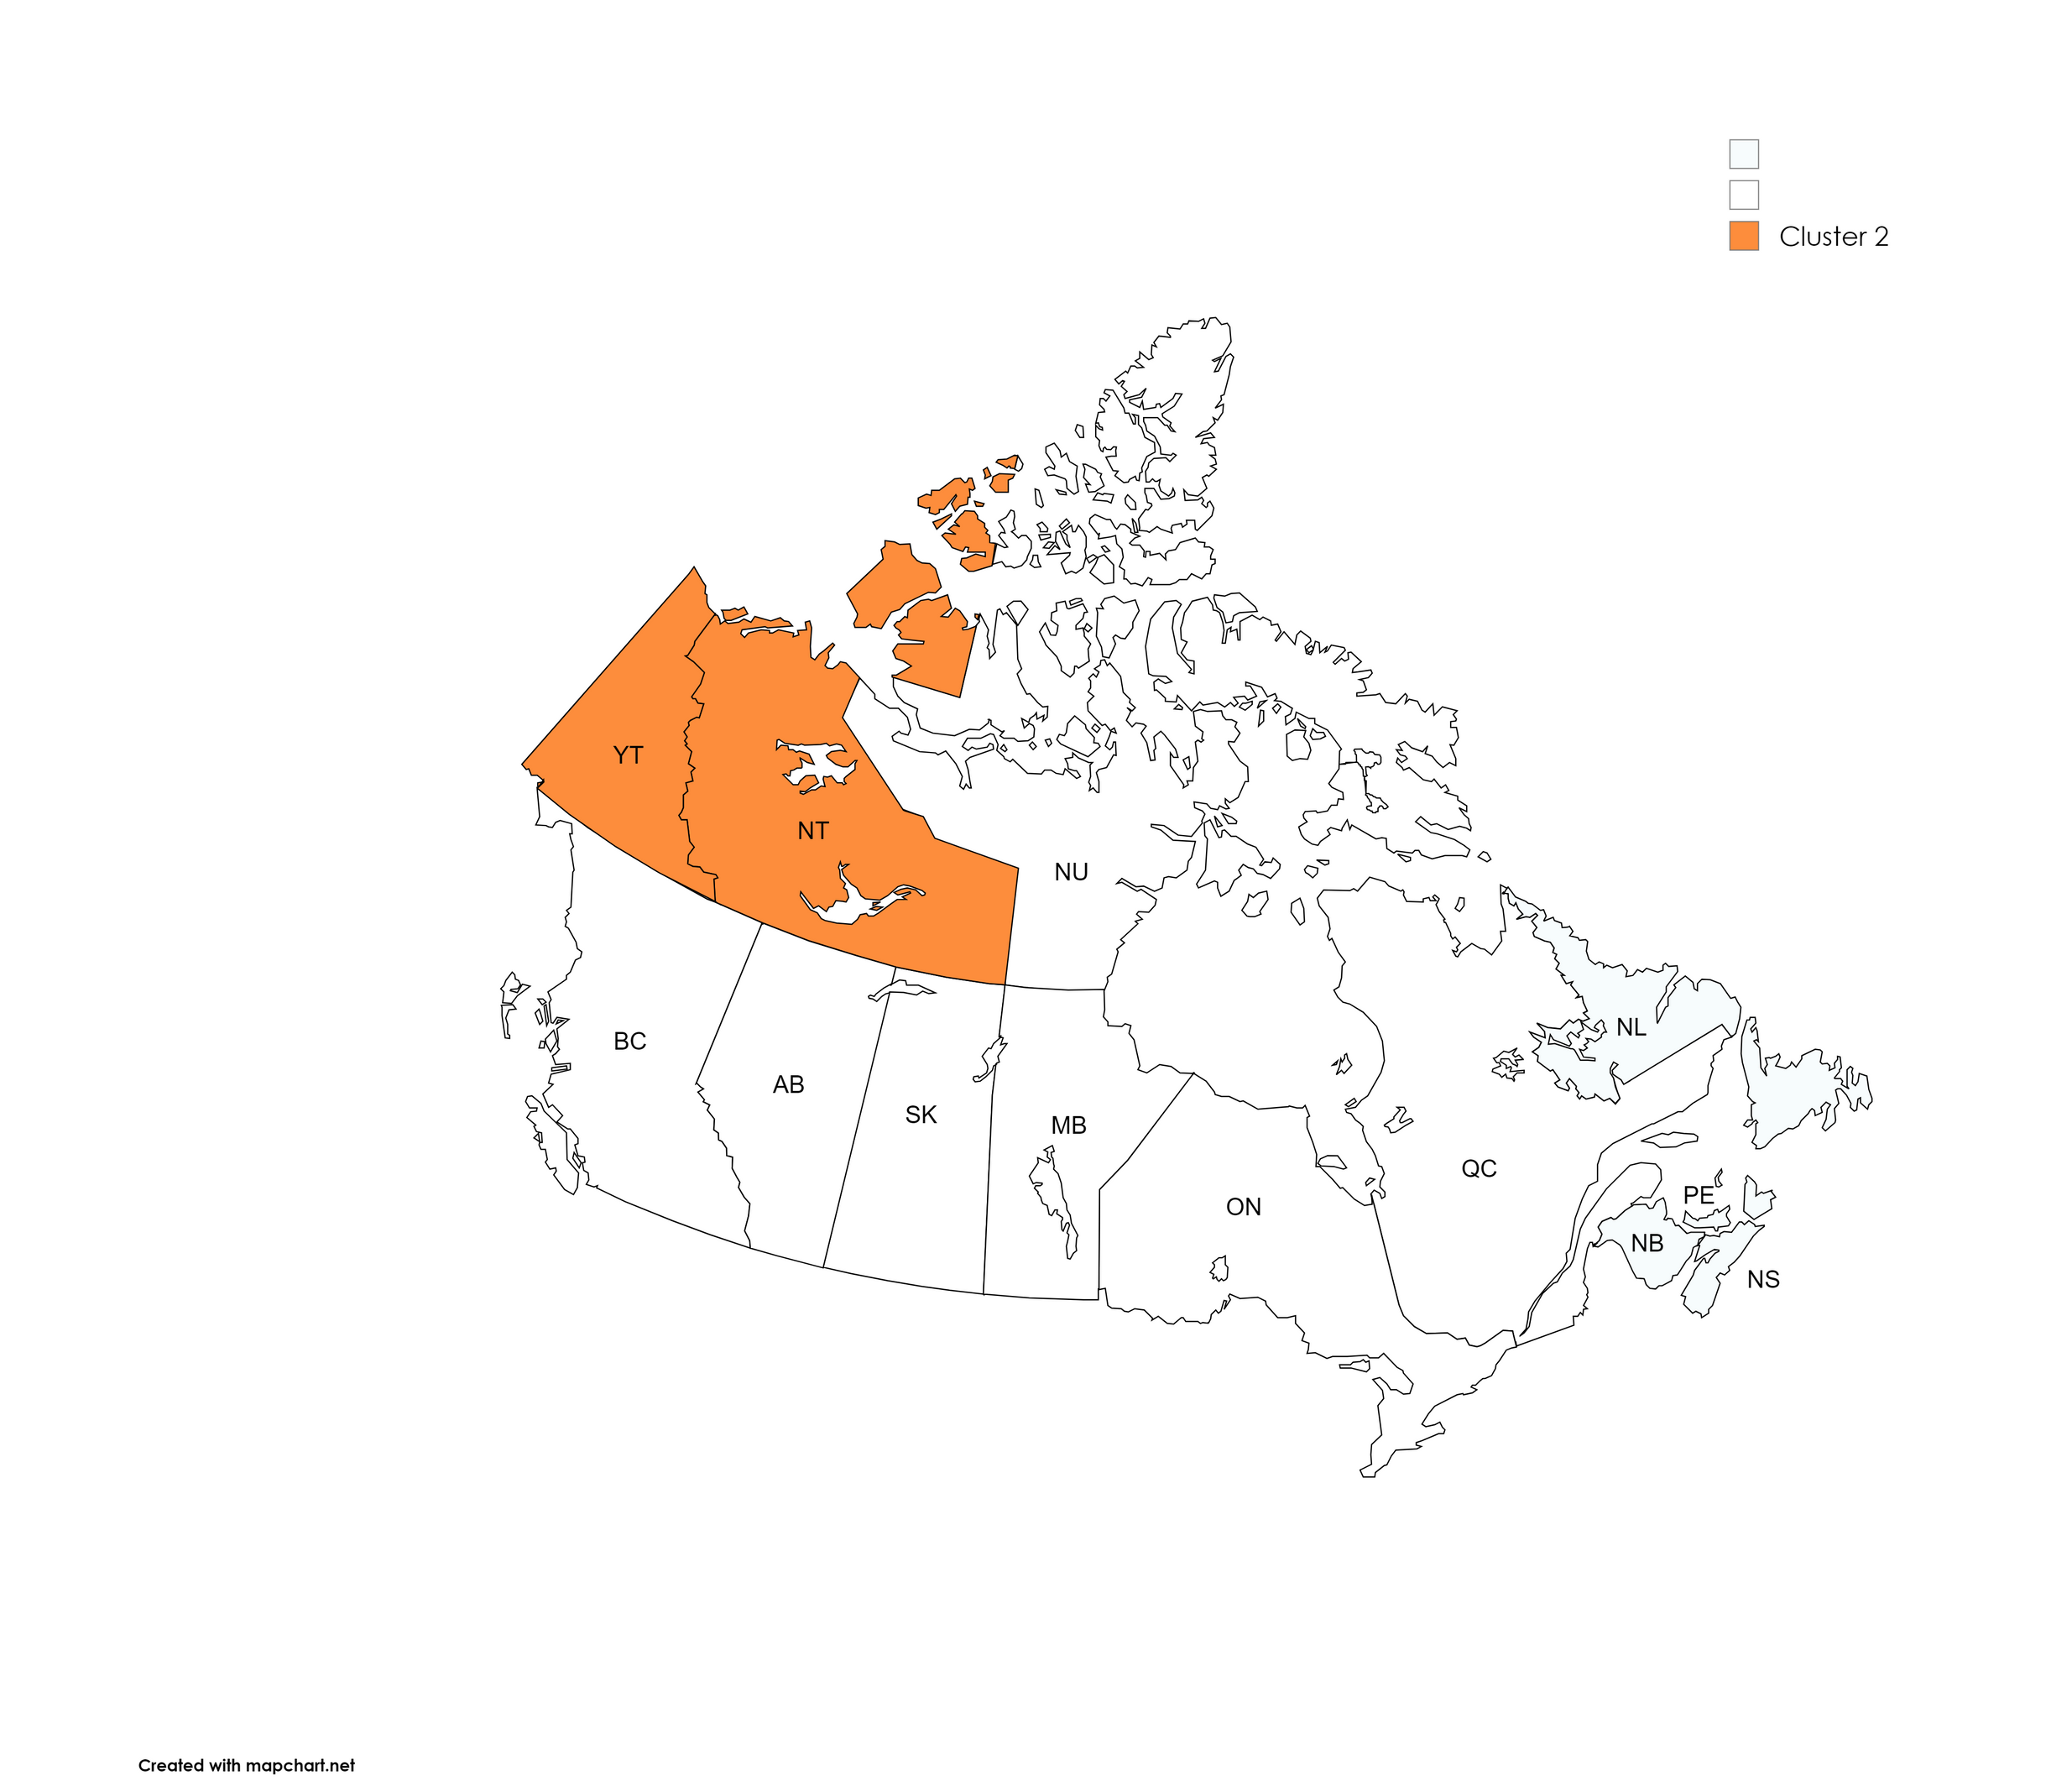
Cluster 2:
Provinces: Yukon, Northwest Territories
Characteristics:
Similar to Nunavut but with slightly better socio-economic outcomes.
Geographical challenges impact healthcare and education.
Lower GDP and median income compared to Cluster 0.

Slide 12
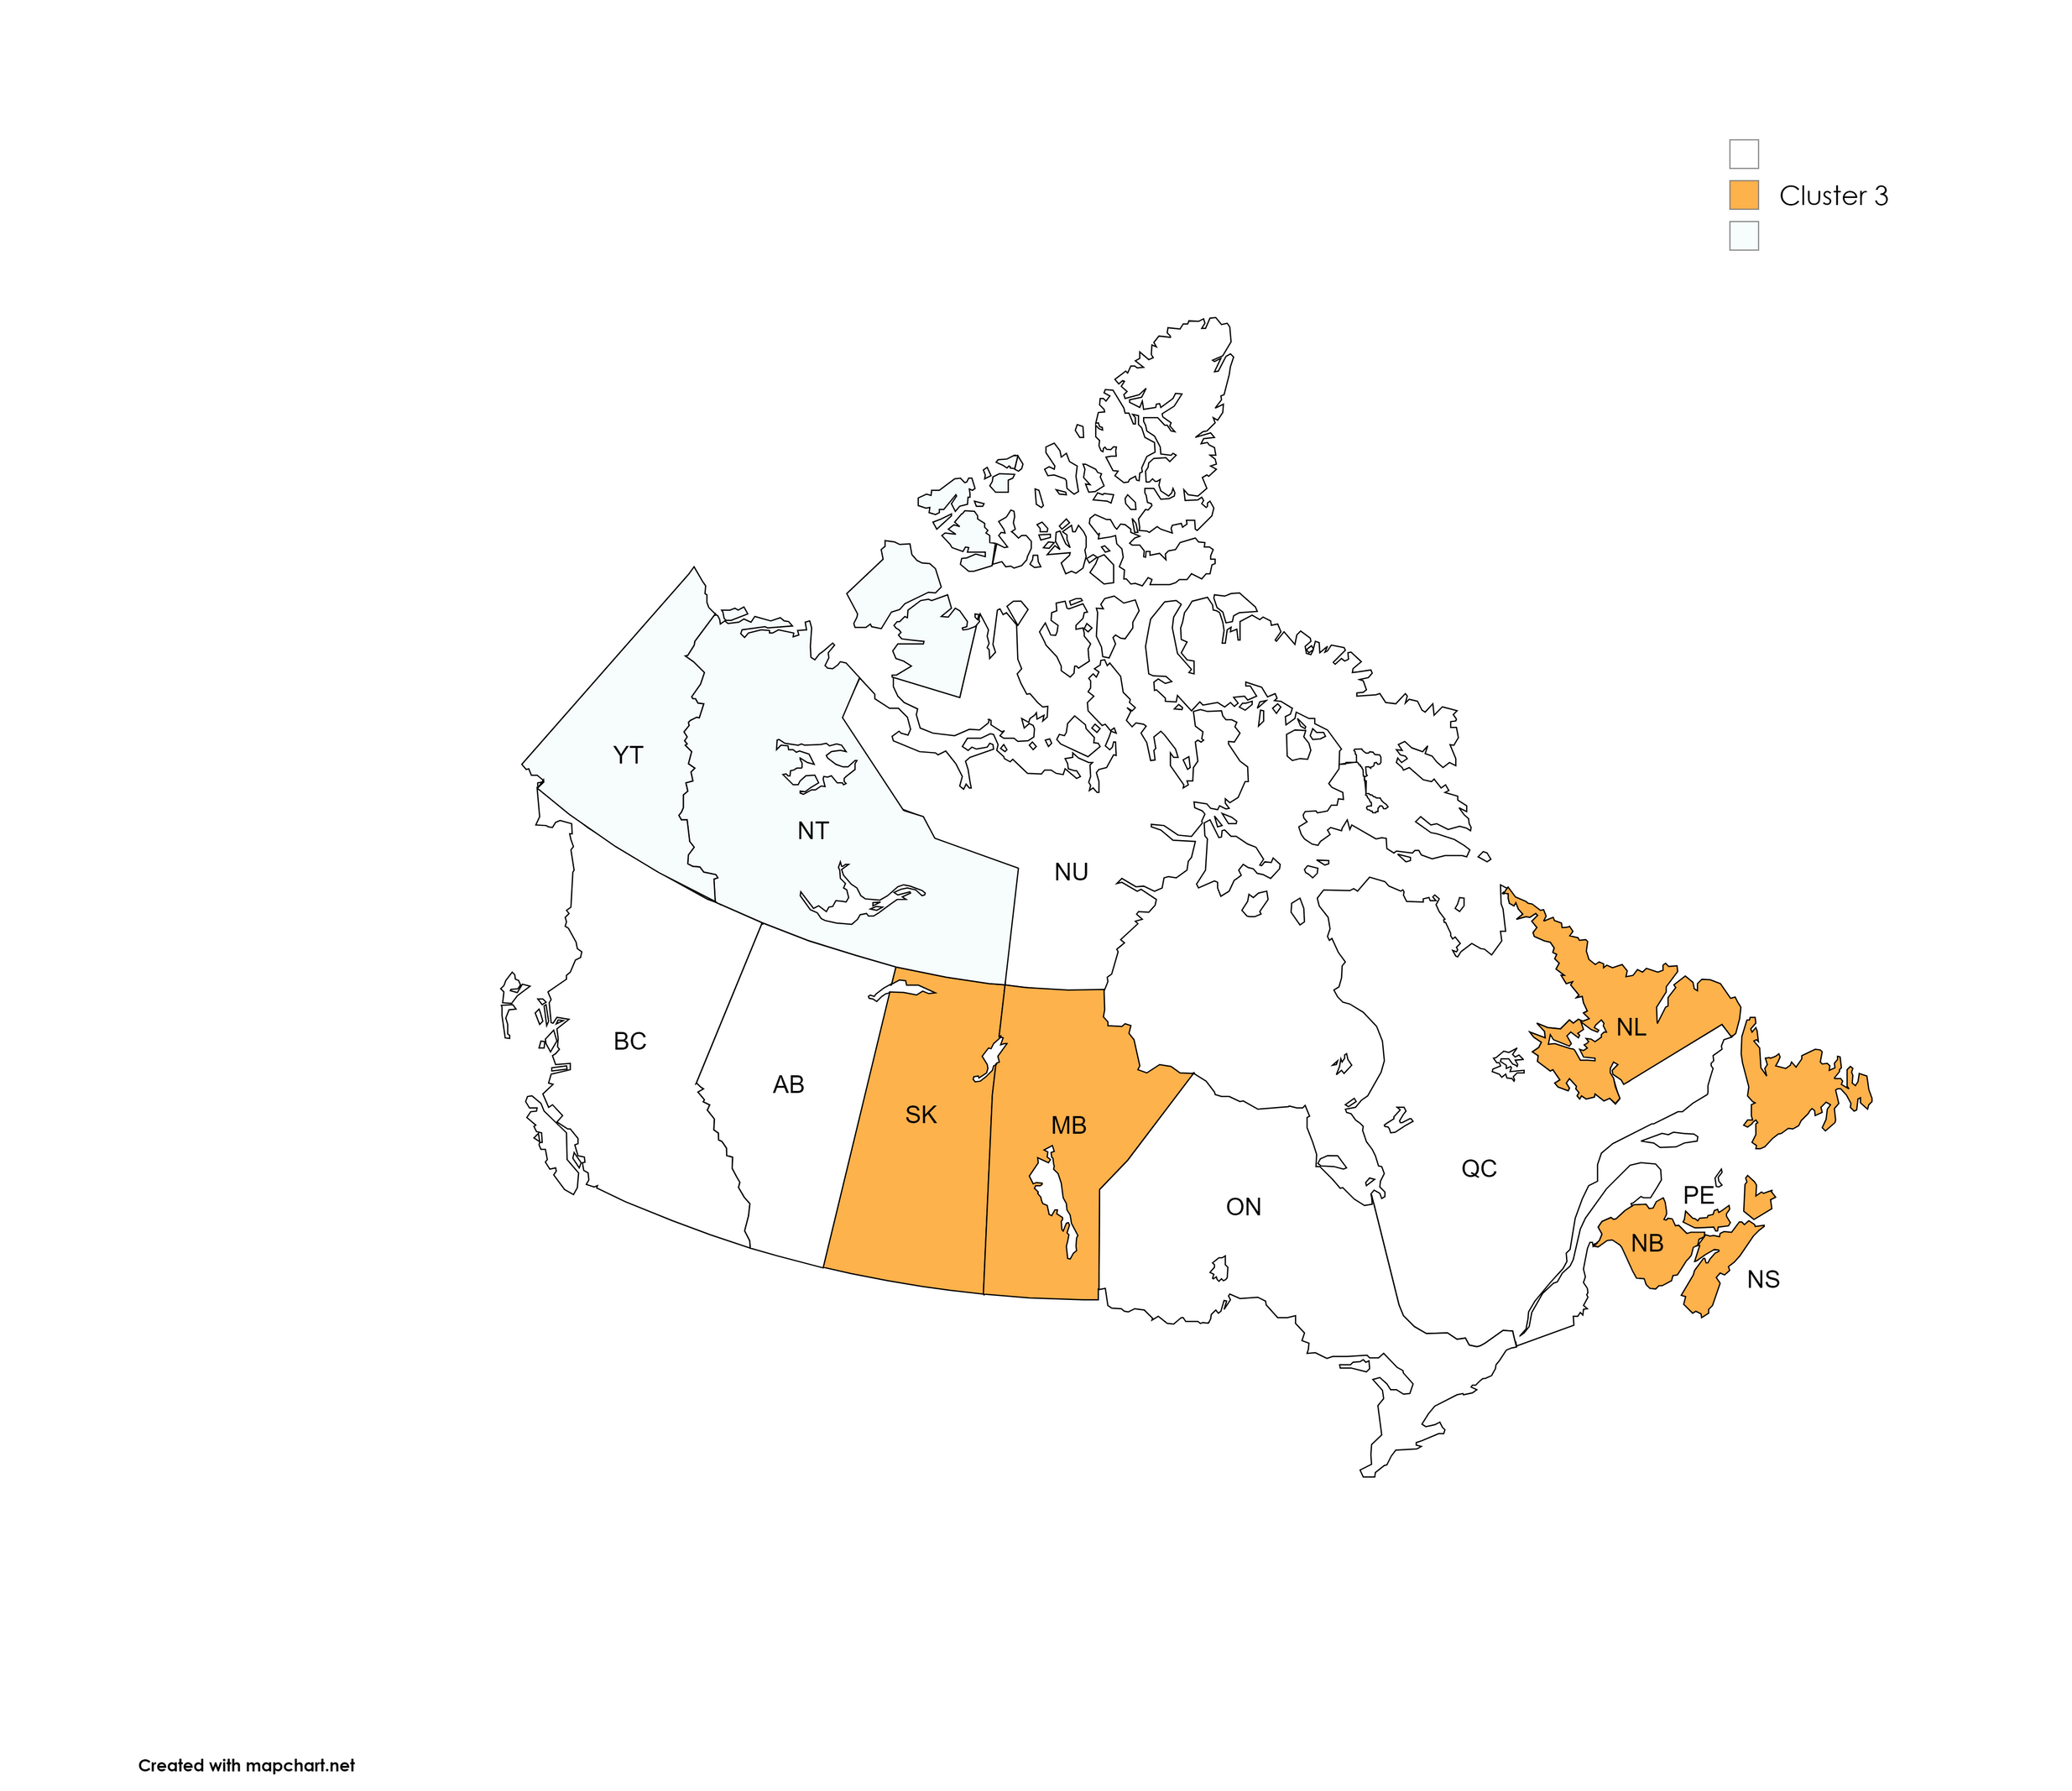
Cluster 3:
Provinces: Canada, Newfoundland and Labrador, Prince Edward Island, Nova Scotia, New Brunswick, Manitoba, Saskatchewan
Characteristics:
Moderate life expectancy, family income, and GDP.
Varied healthcare and education systems.
Less extreme outcomes compared to Clusters 0 and 1.

Slide 13
Findings
Life Expectancy: Highest in Cluster 0, lowest in Cluster 1 (Nunavut).
Education Expenditure: High in Cluster 0; lower in Clusters 1 and 2.
Median Family Income: Highest in Cluster 0, with Clusters 1 and 2 trailing.
GDP: Follows the same trend as family income, reflecting economic disparities.
Drug Abuse: Elevated in Cluster 1 due to socio-economic challenges.

Slide 14

Targeted Health Interventions for Remote and Northern Regions
01
02
Balanced Investment in Education
Recommendations
Economic Development in Disadvantaged Areas
03
Comprehensive Drug Abuse Prevention and Rehabilitation Programs
04

